Slide 1
Engineering Drawing

Slide 2
What is Drafting?
It is a form of graphic communication that is concerned with the preparation of the drawings needed to develop and manufacture products.
It is a very important part of modern industry because drawings are often the only way to explain or show our ideas.

Slide 3
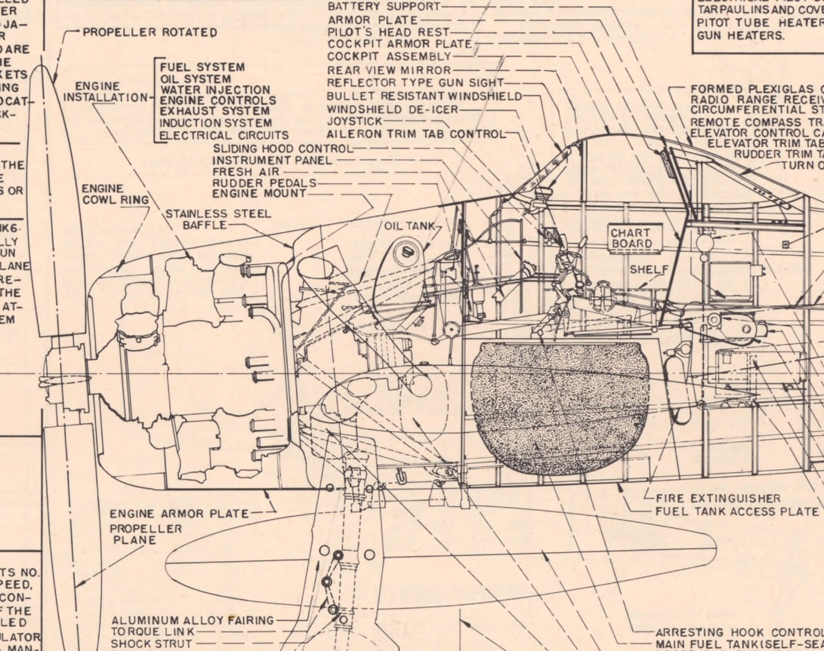
Why is Drafting Called a Universal Language?
Like other languages, symbols (lines and figures) that have specific meaning are used.
The symbols accurately describe the shape, size, material, finish, and fabrication or assembly of a product.
These symbols have been standardized over most of the world.
This makes it possible to interpret or understand drawings made in other countries.

Slide 4
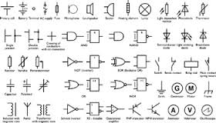
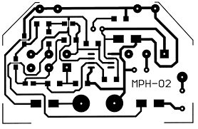
Specialized Fields of Drafting:
Aerospace
Architectural
Electrical
Electronic
Printed circuit design
Topographical

Slide 5
Alphabet of Lines
Border Line
Object Line
Dimension Line
Extension Line
Hidden Line
Center Line

Slide 6
Mechanical CAD
Terms
AutoDesk
Mechanical CAD
Start Menu
AutoCAD 2016 English
Distribution Folder
Save
Save As
U: Drive folder
Rotate View
Counter Clockwize

Slide 8
Getting Started
START

Slide 9
Select “Computer”

Slide 10
Select “002LJTDist” folder

Slide 11
Select “Mechanical CAD 2016” folder

Slide 12
Select “Assignment 1” file

Slide 13
What is CAD Curriculum?
Step by step instructions on how to use AutoCAD 2016.

Slide 14
What will I be doing today?
Go to the computer,
Login if you have not.
Navigate to the Distribution folder and open Assignment 1 of the CAD curriculum.
Start a new drawing.
Save the drawing as C1 in your U: Folder (002lJT___)

Slide 15
Page 13 of the Curriculum Explains how to SAVE your file.

Slide 16
You have arrived at the CAD Curruiculum!

Slide 29
Select All Programs

Slide 30
Select Autodesk

Slide 32
Organize Notebooks

Slide 33
NOTEBOOK ORGANIZATION
Get out your notebook
Be ready to organize

Slide 34
Order of Pages
Cover: Full Name/Engineering and Technology/Period
Page One: Assignment List
Page two: What is Drafting Notes
Page three: Alphabet of lines

Slide 35
List of Assignments
Cost of Living
The Lonely Road
Engineering Career PowerPoint
Engineering Career Test
General Safety Test
Notebook Grade: Do you have one?
General Safety Contract
Engineering Practice Drawings

